Slide 1
DBMS Languages
Data Definition Language (DDL)
Data Manipulation Language (DML)
High-Level or Non-procedural Languages: These include the relational language SQL
May be used in a standalone way or may be embedded in a programming language
Low Level or Procedural Languages:
These must be embedded in a programming language

Slide 2
DBMS Languages Contd..
DDL
Used by the DBA and database designers to specify the conceptual schema of a database.
In many DBMSs, the DDL is also used to define internal and external schemas (views).
In some DBMSs, separate storage definition language (SDL) and view definition language (VDL) are used to define internal and external schemas.
SDL is typically realized via DBMS commands provided to the DBA and database designers

Slide 3
DBMS Languages Contd..
DML
Used to specify database retrievals and updates
DML commands (data sublanguage) can be embedded in a general-purpose programming language (host language), such as COBOL, C,C++, or Java.
A library of functions can also be provided to access the DBMS from a programming language
Alternatively, stand-alone DML commands can be applied directly (called a query language).

Slide 4
Types of DML
High Level or Non-procedural Language:
For example, the SQL relational language
Are “set”-oriented and specify what data to retrieve rather than how to retrieve it.
Also called declarative languages.
Low Level or Procedural Language:
Retrieve data one record-at-a-time;
Constructs such as looping are needed to retrieve multiple records, along with positioning pointers.

Slide 5
DBMS Programming Language Interfaces
Programmer interfaces for embedding DML in programming languages:
Embedded Approach: e.g. embedded SQL (for C,C++, etc.), SQLJ (for Java)
Procedure Call Approach: e.g. JDBC for Java,ODBC for other programming languages
Database Programming Language Approach: e.g. ORACLE has PL/SQL, a programming language based on SQL; language incorporates SQL and its data types as integral components

Slide 6
Database System Utilities
To perform certain functions such as:
Loading data stored in files into a database.
Includes data conversion tools.
Backing up the database periodically on tape.
Reorganizing database file structures.
Report generation utilities.
Performance monitoring utilities.
Other functions, such as sorting, user monitoring, data compression, etc.

Slide 7
DBMS Interfaces
Stand-alone query language interfaces
Example: Entering SQL queries at the DBMS interactive SQL interface (e.g. SQL*Plus in ORACLE)
Programmer interfaces for embedding DML in programming languages
User-friendly interfaces
Menu-based, forms-based, graphics-based, etc.

Slide 8
Database System Utilities
To perform certain functions such as:
Loading data stored in files into a database.
Includes data conversion tools.
Backing up the database periodically on tape.
Reorganizing database file structures.
Report generation utilities.
Performance monitoring utilities.
Other functions, such as sorting, user monitoring,data compression, etc.

Slide 9
Other Tools
Application Development Environments and CASE (computer-aided software engineering) tools:
Examples:
PowerBuilder (Sybase)
JBuilder (Borland)
JDeveloper 10G (Oracle)

Slide 10
Database Models
Definition: collection of logical constructs used to represent data structure and relationships within the database
Conceptual models: logical nature of data representation; if emphasizes on what entity is presented; it is used for database design as blueprint
Implementation models: emphasis on how the data are represented in the database
Notes:
Database models can be grouped into two categories : Conceptual models and implementation models. Conceptual model is concerned with what is represented in the database rather than how it is represented. Conceptual models include Entity-Relationship model and the Object-Oriented model

Slide 11
Database Models
Conceptual models include
Entity-relationship database model (ERDBM)
Object-oriented database model (OODBM)
Implementation models include
Hierarchical database model (HDBM)
Network database model (NDBM)
Relational database model (RDBM)
Object-oriented database model (OODBM)

Slide 12
Outline
Hierarchical (tree)
Data is organized top-down
Network
Owner-membership relationship
A member can have many owners
Relational
Uses tabular format with 2-dimensional tables (relations)
Relations resemble files

Slide 13
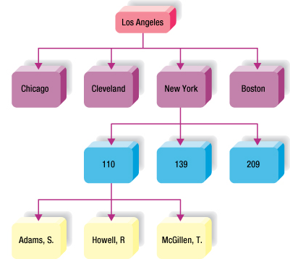
Hierarchical Database
Logically represented by an upside down tree
Each parent can have many children (segment linkage)
Each child has only one parent
Notes:
Fields or records structured in nodes; viewed as branches of an upside-down tree
Each item is subordinate to its parent node; only one parent per node; parent can have several child nodes
The subordinate item is the child node to the parent
If parent node is deleted, all the child nodes deleted
New parent node must be created before adding new child node
Limited by rigid structure
No direct relationships between child nodes between child nodes

Slide 14
Hierarchical Database Model : Advantages
Conceptual simplicity: relationship between layers is logically simple; design process is simple
Database security: enforced uniformly through the system
Data integrity
Data independence
Efficiency in 1:M relationships and when uses require large numbers of transactions
Dominant in 1970s , when we used mainframe system with large databases

Slide 15
Hierarchical Database Model
Disadvantages
Complex implementation: physical data storage characteristics; database design is complicated
Difficult to manage and lack of standards
Lacks structural independence
Applications programming and use complexity (pointer based)
Implementation limitations, i.e. especially it only handle 1:M type of model
Little scope for Query Optimization

Slide 16
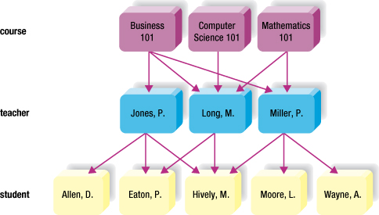
Network Database
Hierarchical like node arrangement
Child node can have more than 1 parent
Many-to-many relationships
Access via multiple pathways
Flexible, powerful
Notes:
Also has hierarchical node arrangement -- but here child nodes may have more than one parent node.
This makes many-to-many relationships possible.
The interconnected design allows for access via multiple pathways; i.e., more flexible and powerful.

Slide 17
Network Database Model
Advantages
Conceptual simplicity, just lime HDM
Handles more relationship types (but all 1:M relationship)
Data access flexibility
Promotes database integrity
Data independence
Conformance to standards
Disadvantages
System complexity
Lack of structural independence

Slide 18
Relational Model
What is Relational Model ?
Who developed ?
When it was developed ?
What type of structure it follows ?
What are its advantages and disadvantages ?

Slide 19
The Relational Model
Was introduced in 1970 by Dr. E. F. Codd (of IBM)
Commercial relational databases began to appear in the 1980s
Today relational databases have become the dominant technology for database management
Notes:
Some examples of databases
Banking system (ODBS)
Factory shop floor system
Airline reservation system
Credit checking system
Air traffic control system
Library and information system (IDBS)
Marketing information system
Police detective system

Slide 20
The Relational Model
Data is represented in the form of tables, and the model has 3 components
Data structure – data are organised in the form of tables with rows and columns
Data manipulation – powerful operations (using the SQL language) are used to manipulate data stored in the relations
Data integrity – facilities are included to specify business rules that maintain the integrity of data when they are manipulated

Slide 21
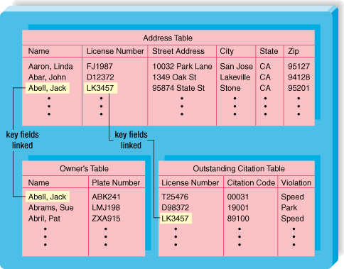
Relational Database
Data stored in tables
Rows and columns
Record = row
Field = column
Most flexible
Tables related via common data item
Easy to use
Notes:
No pre-determined access paths
Data stored in a collection of columns and rows called a table, or a relation
Tables may be logically linked via a key field containing common data
Most valuable feature of relational database: simplicity
Easy to add, delete and modify the data
Easy to add to, delete and modify table structures
Common for microcomputers:
Access
Paradox
dBASE
R:Base

Slide 22
Relational Definitions
A relation is a named, two-dimensional table of data
Every relation has a unique name, and consists of a set of named columns and an arbitrary number of unnamed rows
An attribute is a named column of a relation, and every attribute value is atomic.
Every row is unique, and corresponds to a record that contains data attributes for a single entity.
The order of the columns is irrelevant.
The order of the rows is irrelevant.

Slide 23
Relational Database Model : Advantages
Structural independence: data access path is irrelevant to database design; change structure will not affect the database
Improved conceptual simplicity
Easier database design, implementation, management, and use
Ad hoc query capability with SQL (4GL is added)
Powerful database management system

Slide 24
Relational Database Model : Disadvantages
Substantial hardware and system software overhead
Poor design and implementation is made easy
May promote “islands of information” problems

Slide 25
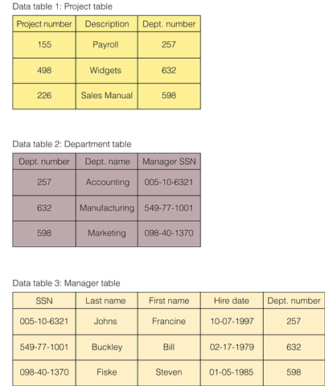
Relational Database Model

Slide 26
Object-oriented Data Models
Several models have been proposed for implementing in a database system.
One set comprises models of persistent O-O Programming Languages such as C++ (e.g., in OBJECTSTORE or VERSANT), and Smalltalk (e.g., in GEMSTONE).
Additionally, systems like O2, ORION (at MCC – then ITASCA), IRIS (at H.P.- used in Open OODB). Object Database Standard: ODMG-93, ODMG-version 2.0, ODMG-version 3.0.

Slide 27
Object-Relational Models
Most Recent Trend. Started with Informix Universal Server.
Relational systems incorporate concepts from object databases leading to object-relational.
Exemplified in the latest versions of Oracle-10i,DB2, and SQL Server and other DBMSs.
Standards included in SQL-99 and expected to be enhanced in future SQL standards.

